Slide 1
K-Means Clustering
Dr Muhammad Ismail Mangrio

Slide 2
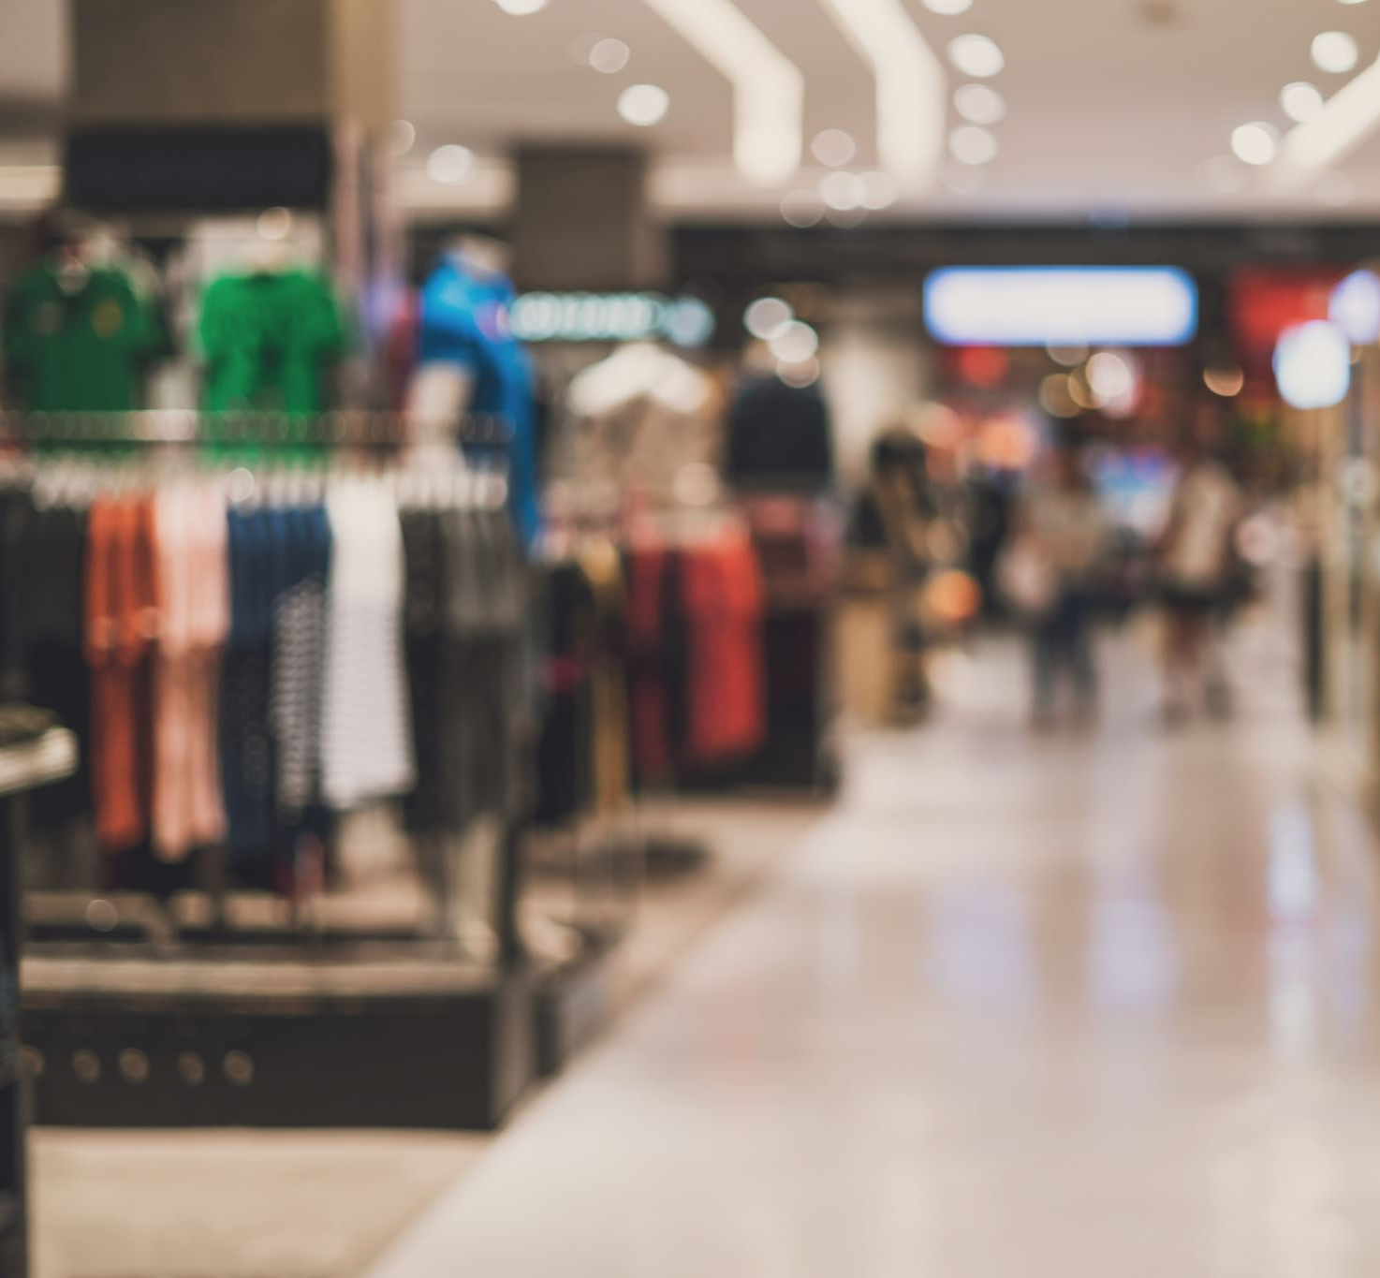
Suppose you are managing a supermarket.
You have data about how much money different customers spend and how frequently they visit.
How can you group customers with similar shopping patterns?
K-Means Clustering
it finds groups (clusters) of similar items in your data automatically, without knowing the labels beforehand

Slide 3
What Is K-Means?
It is an unsupervised learning algorithm used for clustering.
“Unsupervised” means there are no predefined labels (no Pass/Fail, Cat/Dog).
The algorithm looks at your data and tries to find patterns or groups on its own.
“K-Means groups similar data points together based on their closeness (distance).”

Slide 4
Student | Math Marks | English Marks
A | 90 | 85
B | 88 | 80
C | 30 | 40
D | 25 | 35
E | 70 | 65

Slide 5
How K-Means Works (Step-by-Step)
Step | Explanation
1. Choose K | Decide how many clusters (groups) you want (e.g., K = 3).
2. Pick Initial Centers (Centroids) | The algorithm picks K random points as starting “centers.”
3. Assign Points | Each data point is assigned to the nearest centroid.
4. Recalculate Centroids | Compute new cluster centers by averaging the points in each cluster.
5. Repeat | Keep repeating steps 3–4 until the centroids don’t move much (convergence).

Slide 6
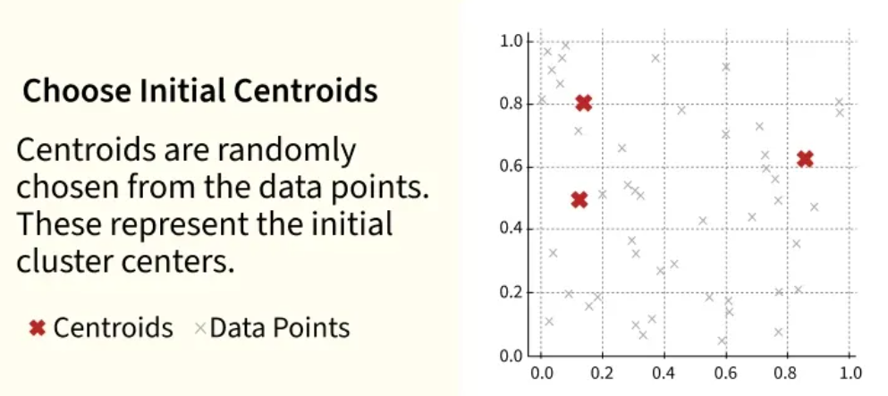

Slide 7
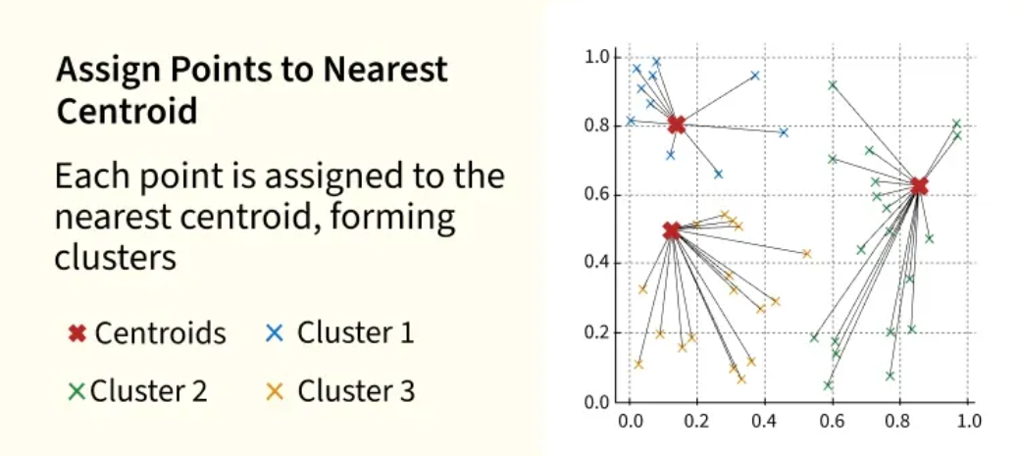

Slide 8
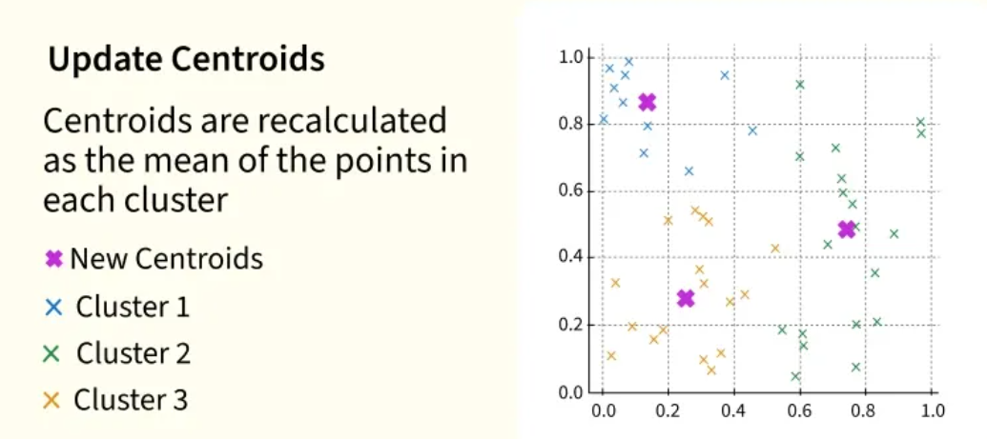

Slide 9
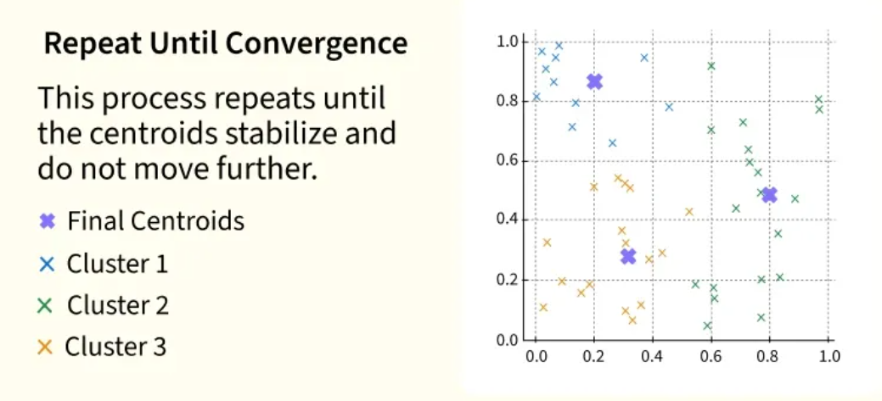

Slide 10
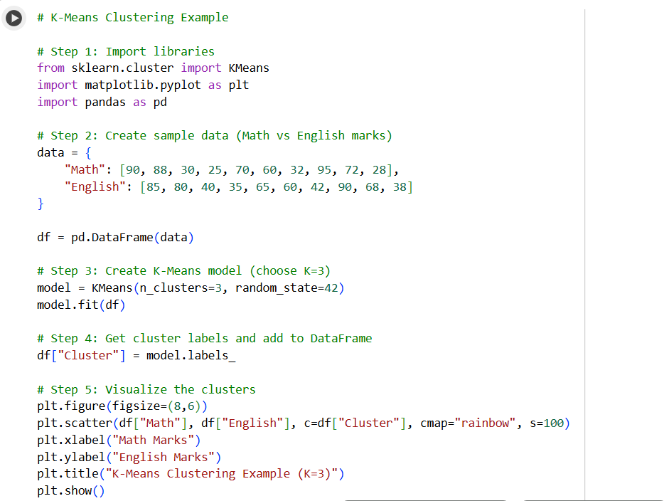

Slide 11
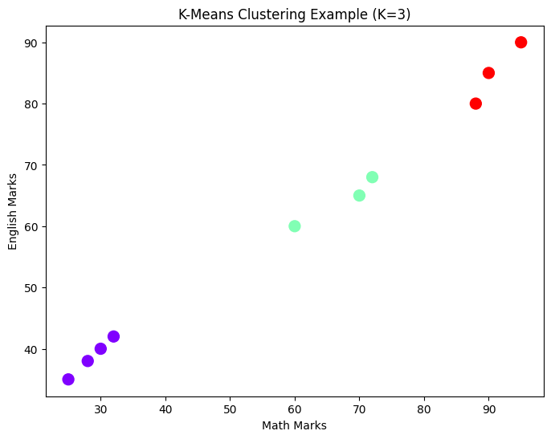

Slide 12
Choosing K (Number of Clusters)
You can try different K values (like 2, 3, 4, etc.) and see which fits best.
To find the best K, use the Elbow Method (optional for first-year):
Plot the total distance (inertia) vs number of clusters.
The point where the graph bends (“elbow”) gives the optimal K.

Slide 13
Comparison with Previous Algorithm (DT)
Algorithm | Type | Goal | Example
Decision Tree | Supervised | Predict class labels | Pass/Fail
K-Means | Unsupervised | Find hidden groups | Customer Segmentation

Slide 14
Summary
Concept | Meaning
K-Means | Clustering algorithm that groups similar data points
K | Number of clusters you want
Centroid | The center point of each cluster
Goal | Minimize the distance between points and their cluster center
Use Cases | Market segmentation, image compression, document grouping, customer analysis
K-Means is like a sorting machine — it automatically groups similar things together without being told what they are.
It’s simple, powerful, and widely used in data science applications.

